Slide 1
CSS/CRIS Change Data Capture (CDC) Options DRAFT
October 2021
v0.6

Slide 2
Executive Summary
There are current challenges of getting Customer change data out of mainframe-based customer source systems (CRIS and CSS) and make them available to the downstream systems or business processes in real-time or near real-time. There are many digital and analytical initiatives that are looking for customer data as soon as it is created in source systems. There are two requirements that we need to satisfy. First, capture change data from source systems in real or near-real time. Second, make them available to the downstream systems.

Slide 3
Progress so far…..
Identified high level requirements keeping future in mind
Understood current state of both source systems
Identified current challenges and issues with source systems for supporting change data capture (CDC)
Reviewed and confirmed that current CDC solution would not satisfy requirements
Research and identified possible new tool options
Identified top 3 vendor tools
Connected with selected vendors and discussed requirements, architecture, and estimated cost
Setup selected vendor demos
Note: Above plan assumes that we do not need to do POC.

Slide 4
Requirement
# | Requirement Category | Requirement Detail | Consumers/Use cases
1 | Source systems data accessibility | Able to access any customer data changes from both source systems in real-time to near real-time Able to prioritize as per the data needs and classification | Customer Data Platform - Reltio master data repository, Snowflake enterprise consolidated data repository
2. | Availability | Customer data available to downstream systems 24x7, near real-time or batch Able to provide access to incremental changes | CRM/Salesforce, AMI, Digital programs, SAP, Web applications etc
3. | Volume | All customers from both source systems All business data for each customer from both source systems | Customer Data Platform - Reltio master data repository, Snowflake enterprise consolidated data repository AMI, Digital programs
4. | Reduce resource usage on Mainframe servers | Offload the Mainframe server load to reduce the MIPS usage Add required resources to mainframe server requires for the new solution | CSS, CRIS mainframe DB2z systems
5. | Future proof | Able to support future CSS records volume increase | CRIS customers migration to CSS

Slide 5

CSS Current State
Source
Change Data
Target
Issues:
1
CSS system batch processes all transactions at night for the performance reason
No audit columns available in key CSS tables
Only around 40 CSS tables are replicated to CDC tables (with audit columns) out of more than 100 total tables using SQLReplicator
Each early morning a batch process pushes incremental change records from CSS CDC tables to Azure MS SQL for the downstream use
Mainframe/DB2 v11.1
MS SQL 2016
2
1
2
CSS
3
CSS CDC
Stage
3
4
Replicator
MS SQL
4
Legend
Database
#
Issue
Real-time
Batch
Notes:
Bottom-up view of enabling Data Capabilities in support of prioritized business capabilities
- Iterative approach to building out capabilities incrementally though data enablement – Clean data available and under management - Master Data managed under MDM and both Master and Transaction Data Available within the Data Hub
Business Capabilities sequencing and timelines are still subject to Top-Down Analysis under the Program Governance & Alignment and Technology Solutioning Towers (taking place over the next 3-4 months, but subject to funding)
- Programs need to re-align priorities and release plan, cross-program gaps and dependencies need to be revisited and programs must be funded and resourced accordingly. This is especially impacted by program gaps in CRM and Automated
Marketing capabilities
- Note: CRM and Marketing Automation Completes in Dec 2022
Timelines for many of the required business capabilities extend beyond May-2022 which are being driving by process and tech changes
Some Capabilities that the Blueprint suggests will be dependent on a step change in platform can begin to be enabled by a Step change in data (e.g. Billing Insights). Other such as (New Service Connect) will obviously be clearly be dependent on AMI service

Slide 6

CRIS Current State
Source
Change Data
Target
Issues:
1
CRIS system batch processes all transactions at night for the performance reason. Also, CRIS application is not accessible, and all interfaces are also not available during batch processing
Mainframe resources and performance issue to publish and push change transactions to downstream systems via MuleSoft
All CRIS data changes are available via MuleSoft service in near real-time except during CRIS batch process
Data sync event publication is available only for the customers who have online web profile that are less than 50% customers of total population
Mainframe/DB2 v11.1
1
2
CRIS
Data Sync Event Pub
4
3
2
3
.Net MQ Client
Legend
4
Database
#
Issue
Real-time
Near Real-time
Notes:
Bottom-up view of enabling Data Capabilities in support of prioritized business capabilities
- Iterative approach to building out capabilities incrementally though data enablement – Clean data available and under management - Master Data managed under MDM and both Master and Transaction Data Available within the Data Hub
Business Capabilities sequencing and timelines are still subject to Top-Down Analysis under the Program Governance & Alignment and Technology Solutioning Towers (taking place over the next 3-4 months, but subject to funding)
- Programs need to re-align priorities and release plan, cross-program gaps and dependencies need to be revisited and programs must be funded and resourced accordingly. This is especially impacted by program gaps in CRM and Automated
Marketing capabilities
- Note: CRM and Marketing Automation Completes in Dec 2022
Timelines for many of the required business capabilities extend beyond May-2022 which are being driving by process and tech changes
Some Capabilities that the Blueprint suggests will be dependent on a step change in platform can begin to be enabled by a Step change in data (e.g. Billing Insights). Other such as (New Service Connect) will obviously be clearly be dependent on AMI service

Slide 7
Current Challenges and Risks
# | Challenges | CSS | CSS
1 | Real time refresh | Data refreshed using batch process once a day | Real-time data is pushed using .NET MQ by MuleSoft except during CRIS batch process – outage time
2 | Data completeness | Around 40 tables are replicated out of ~100 in CSS, also data filtered during batch process | 50% of customers with online accounts
3 | Missing Audit columns | Underlying data sources not having audit columns which makes data pull a challenge | Underlying data sources not having audit columns which makes data pull a challenge
4 | Performance Issues | Data extracted as flat files only after batch updates on CSS. Daily batch updates (Meter rates, IVR, CSR, TSR, Field Workers, etc..), file extracts and transfer waiting on batch loads to complete | CRIS system batch processes transactions nightly and this leads to sync and performance issues with Q replication and MuleSoft data transfer
# | Risks | Detail | Status
1 | Batch updates on source systems | Can this be avoided updating real time?, redesigning the source batch updates? or we have to live with current batch updates | Open

Slide 8
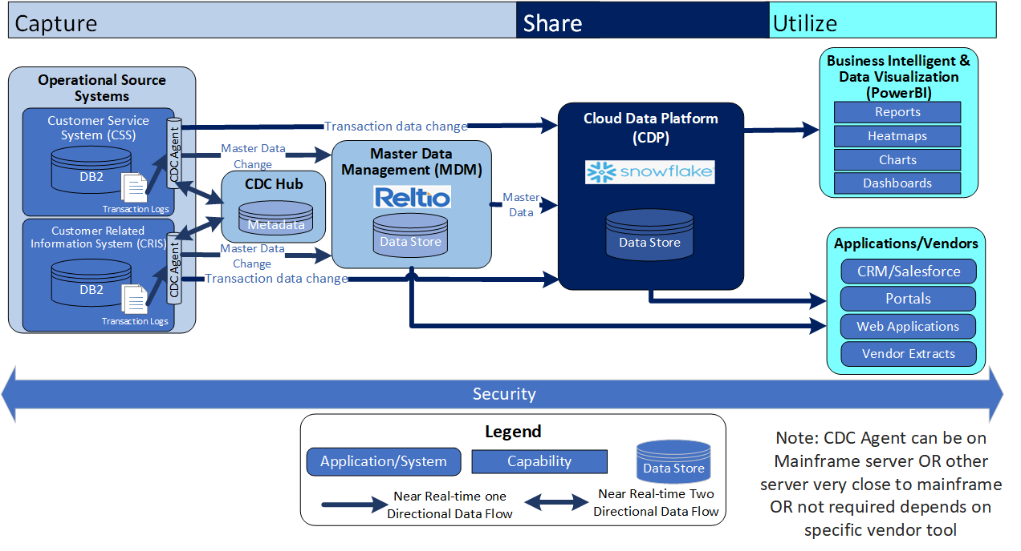
Future Architecture

Slide 9
CDC Options Comparison
 | HVR (Fivetran) | Qlik Replicate | IBM infosphere CDC Data Replication
Description | A lightweight agent installed on each DB2z server. An HRV hub is installed on a separate VM that has the configuration metatdata. An agent reads data from DB2z transaction logs and in real to near real-time loads data to target external database. There is no API based CDC functionality available via MQ. | A lightweight database package called User Defined Table (UDT) function is installed on DB2 that acts as a CDC agent. A Qlik hub/repository is installed on VM closed to DB2z that has the configuration metatdata. An agent reads data from DB2 transaction logs via API and in real to near real-time loads data to target external database. There is no API based CDC functionality available. | Either IBM CDC Native zOS or IBM CDC Remote Source Engine. A hub/repository is installed on VM closed to DB2z that has the configuration metatdata. An agent reads data from DB2 transaction logs via API and in real to near real-time loads data to target external database.
Replication Patterns | DB2z Logs -> Snowflake Stage -> Snowflake (latency in minutes) | DB2z Logs -> Snowflake Stage -> Snowflake (latency in minutes) | DB2z Logs -> Kafka -> API / Snowflake (latency in seconds) DB2z Logs -> Snowflake flat file -> SnowPipe / Snowflake (latency in minutes) DB2z Logs -> DataStage/Matillion/ETL -> Snowflake (latency in minutes)
Cost | License by each source and each target database Estimated around 150K per year with 3 years commitment (Includes training and support) Additional cost for Azure VMs and database for Hub | License by each source, Source server cores, each target database Estimated around 100K with 3 years commitment (includes 120 hours of training and support) Additional cost for VM for Hub | License by each source MIPs Annual estimated cost around 325K with 3 years commitment Additional cost for VM for CDC engine Possibly additional cost for Kafka

Slide 10
CDC Options Comparison
 | HVR (Fivetran) | Qlik Replicate | IBM infosphere CDC Data Replication
MVUs/RVUs requirement | tbd | tbd | tbd
Pros | Well experience in supporting CDC from DB2z to Snowflake DB2z transaction log-based CDC support Support for multiple replication patterns CDC Support for many range of systems and databases Agent install on the mainframe system is not required for DB2z | DB2z transaction log-based CDC support CDC Support for many range of systems and databases | No additional cost for the separate targets databases No additional cost for the any targets databases Support for multiple replication patterns DB2z transaction log-based CDC support CDC Support for many range of systems and databases
Cons | Separate cost for both Reltio (data file) and Snowflake targets Require Unix/Linus server on DXC data center close to DB2 mainframe for agent No direct support for REST API | Separate cost for both Reltio and Snowflake targets No support for MQ based CDC integration No direct support for REST API | License cost is very high May required support from additional tools like Kafka or SnowPipe or ETL No direct support for REST API

Slide 11
Next Steps and plan
Oct 11 – Oct 14: Live demo to showcase NG CDC use case with 3 selected vendors
Oct 15: Based on the demo and initial cost estimate, select 2 finalist vendors
Oct 15 – Oct 29: Complete initial Base Security Review (BSR) of 2 finalist vendor products
Oct 15 – Nov 11: Engage Procurement and commercial for the pricing and contract negotiation
Oct 29 – Nov 11: Select a final vendor based on BSR ratings, user vote (based on demo), and TCO
Nov 11 – Complete and approve Solution Vision document
Nov 19: Finalize and sign contract
Note: Above plan assumes that we do not need to do POC.

Slide 12
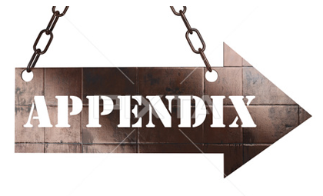

Slide 13
CDC Options High level Comparison
# | Option | Cost | Maintenance | Go to Market Time
1 | HVR | License – By each source and each target database ~150K/year + VM and database for Hub | Maintenance – tbd | Install - Easy Replication Stream - Complex
2 | Qlik(Attunity) Replicate | License – By each source, Source server cores, each target database tbd/year + VM for Hub | Support – Provided, Good documentation | Install - Easy Replication Stream - tbd
3 | IBM InfoSphere Data Replication (IBM CDC) | License – By each source MIPs tbd/year + VM for engine + possibly Kafka (seconds latency) | Maintenance – High | Install – Very Complex Replication Stream - Easy
4 | STRIIM | License – Record counts tbd/year + VM for Hub | Maintenance – Easy Support – Provided | Install – Easy Replication Stream - Required Audit columns
5 | IBM SQL/Queue Replicator
6 | Kafka Connector | License –Usage based | Maintenance – High Support – No provided | Install - Complex Replication Stream – Complex
7 | Oracle Golden Gate | License – Annual and High | Maintenance – High (non-Oracle) | Install – Easy Replication Stream - Easy
8 | IBM DB2 Analytics Accelerator (IDAA) | License – Annual and High | Maintenance – High | Install – Very Complex Replication Stream - Easy

Slide 14
CDC Options High Level Comparison
# | Option | Cost | Maintenance | Go to Market Time
9 | Talend | License – Annual and Low Hardware – 24GB+ RAM | Support – Provided | Install - Complex Replication Stream – Complex
10 | IBM InfoSphere Change Data Delivery | License – Annual and High | The setup is extremely difficult. It is too technical. Data stage is required. | Once you have Infosphere up and running properly, it is stable.
11 | IBM SQLReplicator /QueueReplicator | No additional cost | MInimum as already using it | Should be quick but needs much more storage and processing resources on the Mainframe Requires new setrup or may not work with CRIS
12 | Matillion | License – Annual and High | Should be minimum | Fast once available in FY2022 Q4
13 | Other Tools | HIT Software DB Moto Syniti Data Replication Cdata Sync Data Virtuality Pipes | Equalum informatica Power Exchange Distribute the MQ load

Slide 15
CDC Options
# | Option | Description | CSS | CRIS | Other
1 | HVR | Log-based CDC can be applied to all possible scenarios including systems with extremely high transaction volumes and supported all relational database sources. | Supported | Supported | Supported
2 | Qlik Replicate | High-performance universal data replication platform that is easy to use and offers quick time to value. | Supported | Maybe | Supported
3 | IBM InfoSphere Data Replication (IBM CDC) | IDR Remote Capture as a new solution, although it’s really CDC with a new deployment model and pricing model, off mainframe server. | Supported | Supported | Supported
4 | STRIIM | Replicate data from CSS CDC tables and CRIS data sync event MQ queues | Supported | Supported | Supported
5 | Kafka Connector | Replicate from any supported CDC Replication source to a Kafka cluster by using the CDC Replication Engine for Kafka. This engine writes Kafka messages that contain the replicated data to Kafka topics. | Supported | Supported | Supported
6 | IBM SQL/Queue Replicator | Older IBM replicator used on for the mainframe as source and target. Can not be used for the Snowflake and Reltio target. | Supported | Supported | NA
7 | Oracle Golden Gate | Capable of exchanging and replicating data at the transaction level among several heterogeneous platforms. | Supported | Supported | Supported
8 | IBM DB2 Analytics Accelerator (IDAA) | High-speed analysis of your enterprise data for real-time insight under the control and security IBM Z | Supported | Supported | NA
9 | Talend | CDC in Talend Data Integration is based on a publish/subscribe model. The publisher captures the data changes in real time and makes them available to subscribers. | Supported | Supported | Supported

Slide 16
CDC Option Details
HVR:
Replicating the data from one source to another. It is constantly running, and we do nothing other than looking at monitoring reports. Once it is established, it is pretty much hands-off.
It is CDC and we take data from an OLTP system to populate a data warehouse and to populate a reporting system.
Support log-based CDC for all supported relational database sources.
Some features don't work as advertised for the platform/repository database, and HVR is not always the fastest at getting results.
Qlik (Attunity) Replicate:​
Qlik Replicate (formerly Attunity Replicate) is a high-performance universal data replication platform that is easy to use and offers quick time to value and substantial cost savings when compared to other tools.​
Supports snapshot and real-time or batch-optimized transactional replication, leveraging log-based change data capture, or CDC for database replication technology​
It's more ELT which is one of the advantages. It is also in near real-time, which brings significant advantage for our embedded analytics approach."​
Talend:
It can connect with different databases such as Oracle Database or SQL Server. It allows you to extract the data from one database to another. I can structure the data by filtering and mapping the fields.
It is a data integration tool!

Slide 17
CDC Option Details
Kafka Connector:
You can replicate from any supported CDC Replication source to a Kafka cluster by using the CDC Replication Engine for Kafka. This engine writes Kafka messages that contain the replicated data to Kafka topics.
CDC Replication has two methods for writing to the Kafka topics: a Java API and a REST server protocol. When using the Java™ API, Kafka consumers read the Kafka topics that are populated by CDC Replication using a de-serializer that is compatible with the CDC Avro binary format
Cost MIPS and stability concerns
Oracle Golden Gate:
It is a software that can replicate data from one database to another. It is capable of exchanging and manipulating data at the transaction level among several heterogeneous platforms. It runs on the operating system and is independent of the database.
Oracle CDC replication with zero impact on source
High Cost
Equalum:
Powerful data integration, migration, and replication tool.
Equalum provides a single platform for core architectural use cases, including CDC replication, streaming ETL, and batch ETL.
Reasonably priced
It doesn't work with a typical Git branching and CI/CD deployment strategy

Slide 18
CDC Option Details
CDC Replication:
CDC provides low-impact capture and fast delivery of data changes for key information management initiatives including dynamic data warehousing, master data management, application consolidations or migrations, operational BI, and enabling SOA projects.
CDC also helps reduce processing overhead and network traffic by sending only the data that has changed. You can perform replication either continuously or periodically. When data is transferred from a source server, it can be remapped or transformed in the target environment.
IBM DB2 Analytics Accelerator (IDAA):
High-speed analysis of your enterprise data for real-time insight under the control and security of IBM Z
Db2 Analytics Accelerator on Z is the product feature that runs entirely on a mainframe computer. Unlike IBM® Db2 Analytics Accelerator on an IBM Integrated Analytics System, it does not require external hardware.
Reduces data movement
No physical replication is made, queries are performed on the existing DB2 instance
IBM Data Replication for Db2 for z/OS remote source (IDR):
IBM released Db2 for z/OS Remote Capture as a new solution, although it’s really CDC with a new deployment model – and pricing model.
The deployment model allows you to run the replication engine off the mainframe, which reduces MIPs and also allows you to do the replication monitoring and administration off the mainframe (which may mean it’s easier to get new support folks trained, etc.)
The licensing model is based on the volume of data in Db2 for z/OS – but also supports unlimited targets, at no charge.
Db2 for z/OS versions 11 and 12

